Slide 1
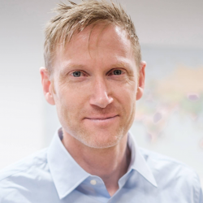
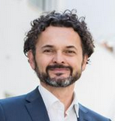
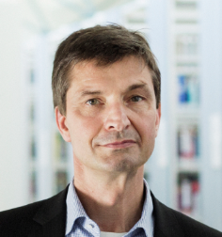
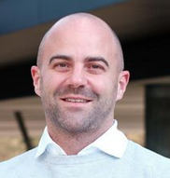
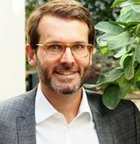
Master of Science in International Economics and Business
Prof. Michael Grimm; Development Economics
Prof. Harry Haupt; Statistics and Data Analytics
Prof. Johann Graf Lambsdorff; Economic Theory
Prof. Stefan Bauernschuster;
Public Economics
Prof. Sebastian Krautheim;
International Economics

Slide 2
Master of Science in International Economics and Business
Economics with focus on “Global Economy, International Trade, and Finance” and/or “Governance, Institutions and Development”
Strong in advanced methods and empirical research (experiments, field studies)
Suitable courses in business (e.g. concerning international transactions or finance)
Self-selected interdisciplinary courses from other faculties (e.g. in law, cultural studies or political science)
Curriculum completely in English
Top position in the CHE ranking
Strong reputation in research
Seminar-style learning in small groups
Close contact to all lecturers and social events
Strong network

Slide 3
Master of Science in International Economics and Business
Occupational field
Economics is open to various fields and positions
Examples are positions in banking, insurance, medium-sized enterprises with an international orientation, consulting, public and international organizations
Doctorate in the field of economics, business administration, political science
Economist have one of the lowest unemployment rates in Germany.

Slide 4
Master of Science in International Economics and Business
373 applications in 2024
138 passed stage 1
Checking the bachelor degree or transcript of records grades and focus on economics and methods
92 participate in interview
33 passed stage 2
Interview via Zoom, consisting of single choice test and presentation

Slide 5
A: Core Courses 25-30 ECTS
B: Adv. Methods $≥$ 10 ECTS
C: Global Econ. $≥$ 10 ECTS
D: Gov & Dev. $≥$ 10 ECTS
E: Business $≤$ 20 ECTS
F: Lan-guage
G: Interdisc.
Advanced Macroeconomics
Advanced Microeconomics
Natural and Field Experiments
Fundamentals of International Trade
Methods in Econometrics
Micro Development Economics
Behavioral Game Theory
Experimental Economics
Methoden der Ökonometrie II
Topics in Applied Econometrics
Multivariate Verfahren/Paneldatenanalyse
Fundamentals of Business Analytics
Seminar Applied Statistics
Advanced Data Analytics
Computational Statistics – Regression and Learning in R
Lectures in Advanced Methods 1 + 2
Advanced International Trade
The Empirics of International Trade
Recent Topics in International Trade
International Monetary Economics
Seminar Advanced Macroeconomics
Neue Standorttheorien
Advanced Corporate Finance 1 + 2
Seminar Advanced Corp. Finance
Lectures in Advanced International Economics 1 + 2
Evaluation of Development Policies
Economics of Corruption
Population Economics
Behavioral Public Economics
Seminar in Public Economics
Economics of Education
Economics of Crime
Health, Development and Public Policy
Growth, Inequality and Poverty
Seminar in Development Economics
Lectures in Governance, Institutions and Development 1 + 2
Organization Theory and Sustainable Leadership
Organizational and Competitive Strategy
Managing and Leading Strategic Innovation and Change
International Accounting
Reporting of Digital Business Models
Advanced International Accounting
Telecommunications Management
Electronic Markets
Organizational Behavior
Financial Statement Analysis
International Cooperation and Networks
Lectures in Advanced Business Administration
English
French
Spanish
Further languages
Interdisci-plinary speciali-zation 1
Interdisci-plinary speciali-zation 2
Interdisci-plinary seminar

Slide 6
Sample curriculum “Global Economics”
1
WiSe
Advanced Macroeconomics
Advanced Microeconomics
Natural and Field Experiments
Fundamentals of International Trade
Behavioral Game Theory
Fundamentals of Business Analytics
2
SoSe
Computational Statistics – Regression and Learning in R
Advanced International Trade
The Empirics of International Trade
International Monetary Economics
Seminar Advanced Macroeconomics
Advanced Corporate Finance 1
3
WiSe
Methods in Econometrics
Advanced Data Analytics
Seminar Advanced Corp. Finance
Advanced Corporate Finance 2
Behavioral Public Economics
Lectures in Advanced International Economics 2
4
SoSe
Recent Topics in International Trade
Population Economics
Master Thesis

Slide 7
Sample curriculum “Governance & Development”
1
Micro Development Economics
Advanced Microeconomics
Natural and Field Experiments
Methods in Econometrics
Behavioral Public Economics
Growth, Inequality and Poverty
WiSe
2
Seminar in Development Economics
Evaluation of Development Policies
Economics of Corruption
Population Economics
Health, Development and Public Policy
SoSe
Computational Statistics – Regression and Learning in R
3
WiSe
Fundamentals of International Trade
Advanced Data Analytics
Behavioral Game Theory
Lectures in Advanced International Economics 1
Behavioral Public Economics
Lecture in Governance, Institutions and Development 2
4
Seminar in Public Economics
International Monetary Economics
Master Thesis
SoSe

Slide 8
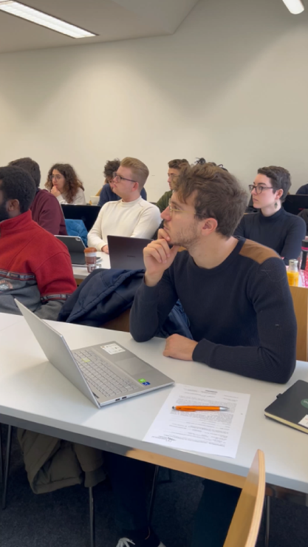
Looking forward to working with you!

Slide 9
Cultural Programme
For all international and local students
International Pub Quiz
What:
When:
Have a good time answering tricky questions together in teams!
Nov 26th
6 - 7 PM
Room 301
Winter Market
What:
When:
Dec 11th
6 - 7 PM
Explore the local Winter Market together with fellow students!
tbd
International Dinner
What:
When:
Sign up
on
StudIP
Share a dish (and a story) from your home country!
Jan 15th
6 - 7 PM
tbd

